Slide 1
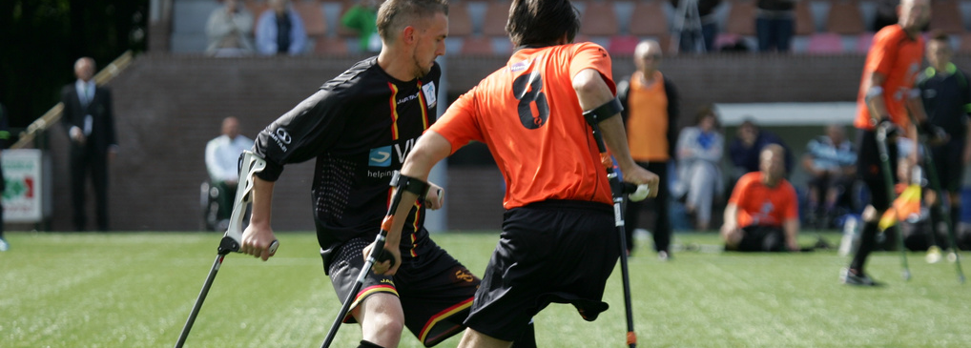
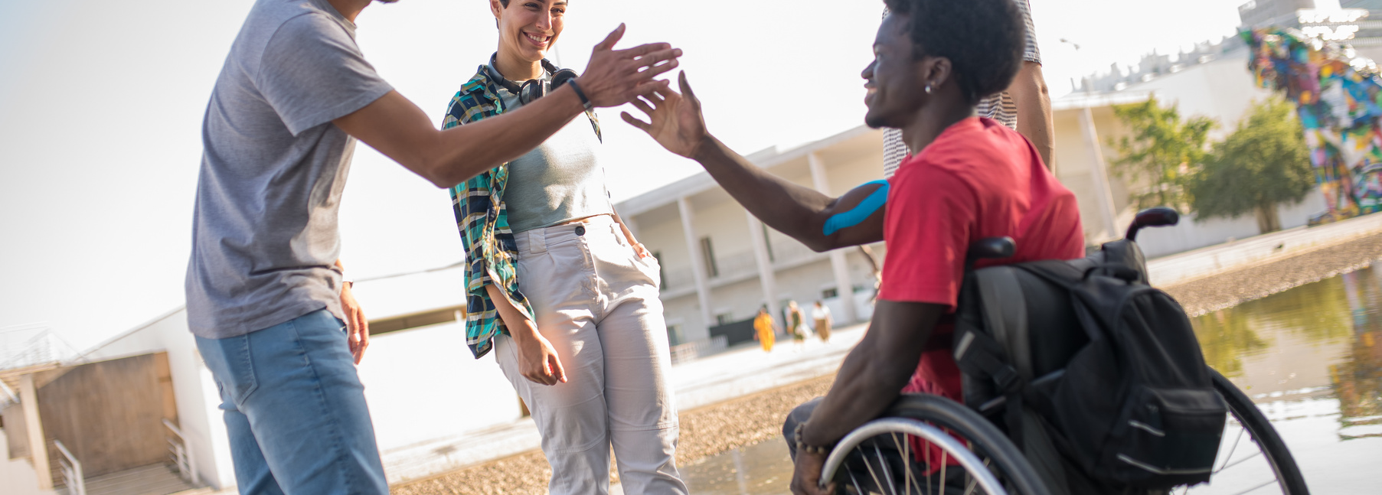
UNIFIED PROFESSION,
UNIFIED VOICE
THERAPEUTIC RECREATION MONTH 2024
www.canadian-tr.org

Slide 2
LAND ACKNOWLEDGEMENT
We respect and acknowledge that we operate on the traditional territories of Indigenous peoples, encompassing a portion of the land and waters of Turtle Island, now known as “Canada.” These lands have been the cherished homes of diverse Indigenous communities for countless millennia, each possessing their own rich cultures, languages, and unique histories.
We hold in the highest regard the enduring connections that Indigenous peoples maintain with Turtle Island and their invaluable contributions to the rich tapestry of “Canada.” With profound respect, we pay our sincere respects to the First Nations, Métis, and Inuit peoples who have diligently stewarded these lands and waters for countless generations.
Furthermore, we acknowledge the persistent challenges and disparities Indigenous communities face in healthcare, education, and resource access across Turtle Island. In partnership with Indigenous peoples, we are unwavering in our commitment to foster understanding, reconciliation, and meaningful positive change across this land.

Slide 3
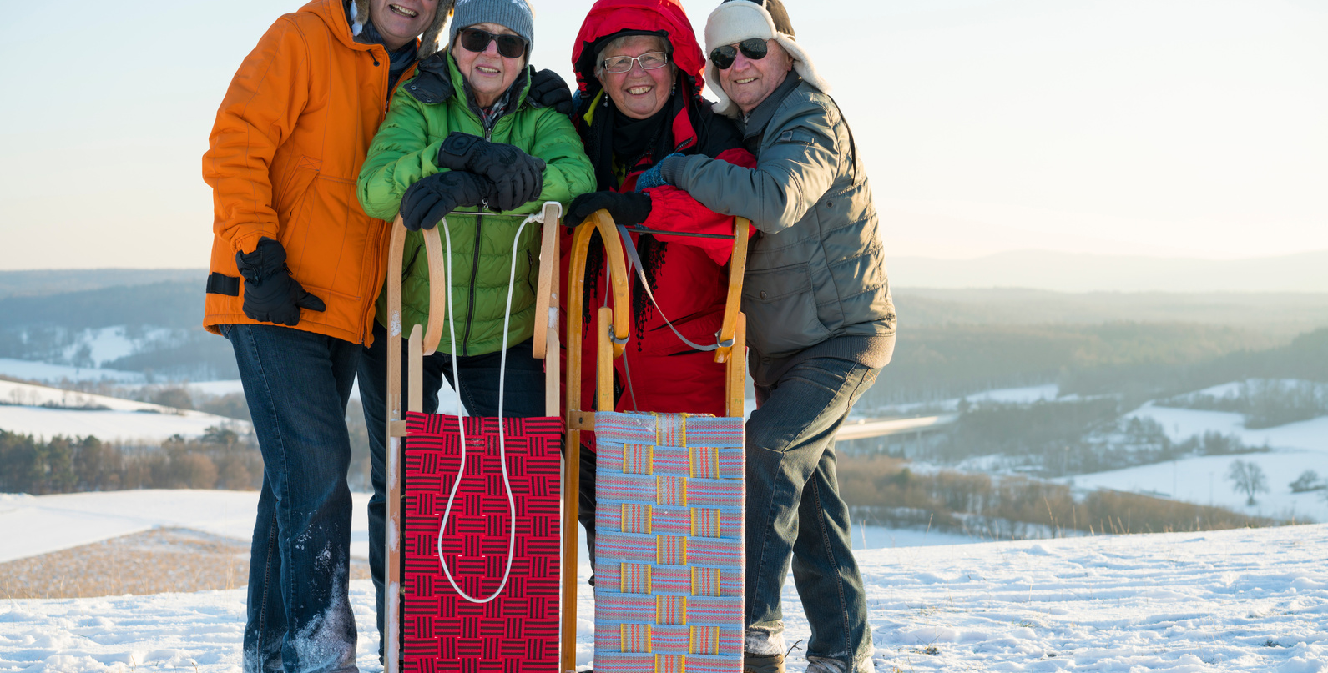
WHAT IS THERAPEUTIC RECREATION/
RECREATION THERAPY?
Recreation Therapy is a health profession which takes a person-centred, strengths-based, evidence-informed approach to practice. Recreation therapists and recreation therapy assistants use recreation and other leisure-based interventions to address the assessed needs of clients with illness and/or disabling conditions to enhance psychological and physical health, recovery, and well-being (CTRA, 2022; NCTRC, 2022)

Slide 4
WHY RECREATION THERAPY?
Gives a sense of purpose and contribution
Provides a safe environment to experience both challenge and success
Focuses on what you CAN do, and WHO you are
Gives opportunities for a sense of normalcy

Slide 5
WHY RECREATION THERAPY?
Inclusive and supportive
Evidence and strength-based
Opportunity to create connection
Provides an opportunity for self-discovery

Slide 6
BENEFITS OF THERAPEUTIC RECREATION
Social
Cognitive
Develop/maintain social skills
Strengthens social connections
Increased community involvement
Decreased social isolation
Increased social support systems
Increased attention span
Improved memory
Improved problem solving skills
Improved cognition levels
Improved time management skills
Goal setting skills

Slide 7
BENEFITS OF THERAPEUTIC RECREATION
Emotional/
Spiritual
Physical
Improved self-confidence
Decreases loneliness, boredom, & expressive behaviours
Increased sense of belonging
Fosters positive experiences
Decreases symptoms of anxiety, stress, & depression
Balance
Range of motion
Strength
Coordination
Improved sleep
Fine & gross motor skills

Slide 8
WHAT IS A RECREATION THERAPIST?
Recreation therapists are integral to the health care team working with diverse populations across varied practice settings, including inpatient, outpatient, and community-based services. The clinical role of the recreation therapist includes assessment, client goal setting, intervention
planning, utilization of evidence-informed interventions, evaluation, and documentation.
Recreation therapists are responsible for service delivery, supervising and working with recreation therapy assistants, where applicable, to support successful program implementation. (CTRA Standards of Practice, 2023)

Slide 9
WHAT IS A RECREATION THERAPY ASSISTANT?
Recreation therapy assistants are integral members of the health care team working with diverse populations across varied practice settings. The recreation therapy assistant works under the direct supervision of a recreation therapist to deliver leisure-based interventions in both one-to-
one and group formats. The recreation therapy assistant is essential in program implementation, observation, and reporting. The recreation therapy assistant cannot conduct assessments, develop intervention plans, or evaluate client progress. (CTRA Standards of Practice, 2023)

Slide 10
ROLES OF THE RECREATION THERAPIST
Assess using various TR assessment tools
Plan client transition and discharge
Develop treatment plans based off of client goals and assessment findings
On-going reporting and evaluating of programs and goals
Implement individual/group evidence-based interventions
Uphold the Standards of Practice
Provide and support successful program implementation
Maintain continuing education

Slide 11
ROLES OF THE RECREATION THERAPY ASSISTANT
Develop, plan, and organize evidence-based recreation programs
Implement individual/group evidence-based interventions
Ensure individual strengths and interests are being met within programming
On-going observation and reporting of programs and goals
Assure Therapeutic Recreation goals are carried out
Uphold the Standards of Practice
Make recommendations based off of evaluation of programs and participant engagment
Maintain continuing education

Slide 12
WHAT TRAINING DO QUALIFIED THERAPEUTIC RECREATION
PROFESSIONALS HAVE?
RECREATION THERAPIST, CTRS
Bachelors Degree or Higher
Professional Member
NCTRC-CTRS Designation
Majoring in Therapeutic Recreation/Recreation Therapy or as accepted by the NCTRC
Membership in good standing with at least one Therapeutic Recreation Associaiton
May hold, or be able to sit for the NCTRC Certified Therapeutic Recreation Specialist exam

Slide 13
WHAT TRAINING DO QUALIFIED THERAPEUTIC RECREATION
PROFESSIONALS HAVE?
RECREATION THERAPIST, NON-CTRS
Bachelors Degree or Higher
Professional Member
Provincial Designation
Majoring in Therapeutic Recreation/Recreation Therapy or as accepted by the NCTRC
Membership in good standing with at least one Therapeutic Recreation Associaiton
May hold a designation as determined by their provincial association

Slide 14
WHAT TRAINING DO QUALIFIED THERAPEUTIC RECREATION
PROFESSIONALS HAVE?
RECREATION THERAPY ASSISTANT
Diploma
Professional Member
Majoring in Therapeutic Recreation/Recreation Therapy
Membership in good standing with at least one Therapeutic Recreation Associaiton

Slide 15
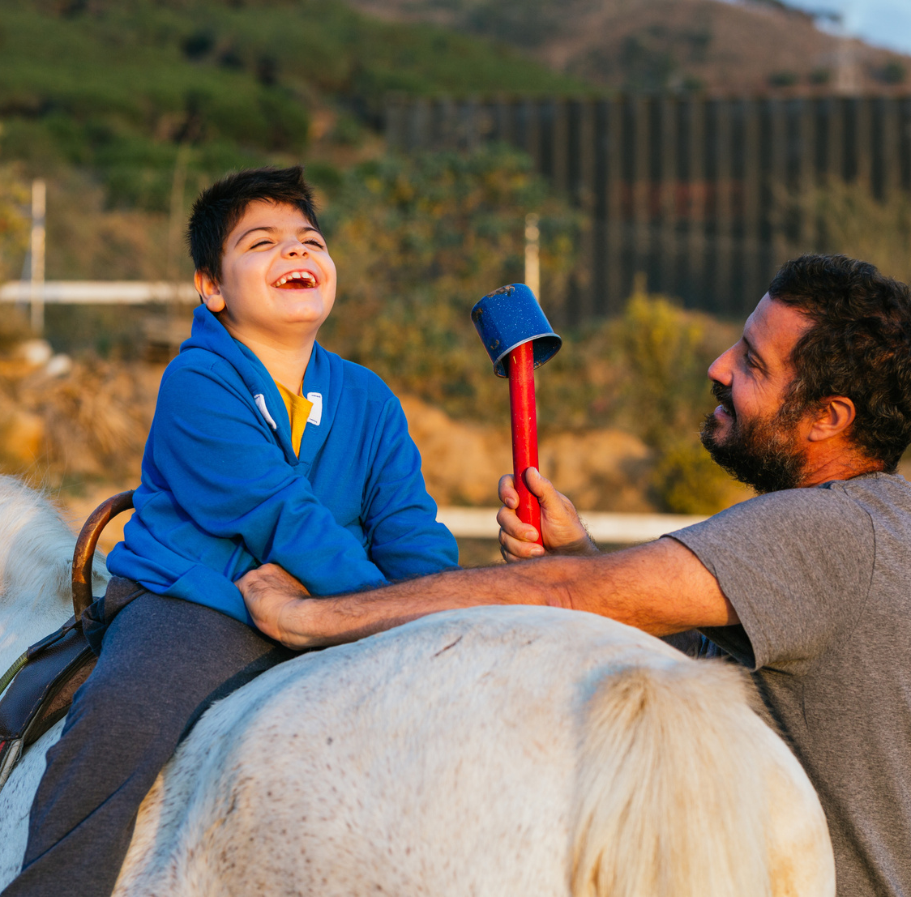
WHERE DO TR PROFESSIONALS WORK?
Longterm Care
Acute Care
Supportive Living
Day Programs
Mental Health and Addiction Services
Pediatric, youth, and adolescent services
Correctional Facilities
Private Practice
Schools

Slide 16
TR ASSOCIATIONS ACROSS CANADA

Slide 17
QUESTIONS?
www.canadian-tr.org

Slide 18
THANK YOU
www.canadian-tr.org

Slide 19
REFERENCES
Bennett, J.L., Craig, P., Aytur, S. et al. Community-Based Recreational Therapy for Veterans with
Behavioral Health Disorders: Impacts on Quality of Life, Participation, and Happiness.
Community Ment Health J 58, 1477–1486 (2022).
Canadian Therapeutic Recreation Association (2023). Standards of Practice. https://canadian-
tr.org/wp-content/uploads/2023/08/CTRA-2023-SoP-FOR-VOTE-August-28th.pdf
Fenton Litwiller, Catherine White, Karen Anne Gallant, Robert Gilbert, Susan Hutchinson,
Barbara Hamilton-Hinch & Heidi Lauckner (2017) The Benefits of Recreation for the Recovery
and Social Inclusion of Individuals with Mental Illness: An Integrative Review, Leisure Sciences,
39:1, 1-19
Kensinger, K. (2019). Recreational Therapy. In: Rieske, R.D. (eds) Handbook of Interdisciplinary
Treatments for Autism Spectrum Disorder. Autism and Child Psychopathology Series.
Springer, Cham.
National Council for Therapeutic Recreation Certification. About recreational therapy. NCTRC.
(n.d.). https://www.nctrc.org/about-ncrtc/about-recreational-therapy/
Yang, Y., van Schooten, K. S., McKay, H. A., Sims-Gould, J., Hoang, R. A., & Robinovitch, S. N. (2021).
Recreational Therapy to Promote Mobility in Long-Term Care: A Scoping Review, Journal of
Aging and Physical Activity, 29(1), 142-161
www.canadian-tr.org

