Slide 1
1
1
2
2
3
3
4
4
Notes:
Family Feud Template
Introduction Slide – The Countdown!

Slide 2
FAMILY FEUD FAMILY FEUD FAMILY FEUD FAMILY FEUD FAMILY FEUD FAMILY FEUD FAMILY FEUD FAMILY FEUD FAMILY FEUD FAMILY FEUD FAMILY FEUD FAMILY FEUD FAMILY FEUD FAMILY FEUD FAMILY FEUD FAMILY FEUD FAMILY FE
FAMILY FEUD FAMILY FEUD FAMILY FEUD FAMILY FEUD FAMILY FEUD FAMILY FEUD FAMILY FEUD FAMILY FEUD FAMILY FEUD FAMILY FEUD FAMILY FEUD FAMILY FEUD FAMILY FEUD FAMILY FEUD FAMILY FEUD FAMILY FEUD FAMILY FE
Notes:
Family Feud Template
Introduction Slide – Family Feud!

Slide 3
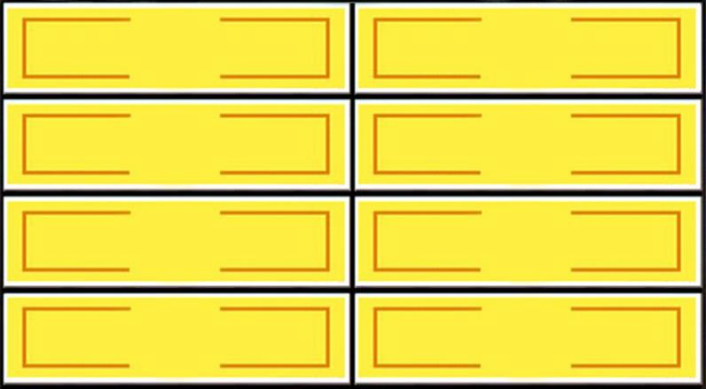
Name a word someone would use to describe Recreation Therapy
Round 1
X
X
X
X
X
X
X
X
X
Leisure
26
Play
5
Community
15
Life
14
Fun
10
X
X
X
Win
Lose
Cheer
Boo
Silence
Notes:
Family Feud Template
5 Panel Slide

Slide 4
Name a parasport that should be a part of the Paralympics but isn’t
Round 2
X
X
X
X
X
X
X
X
X
Para Golf
56
Para Bowling
27
Power Soccer
9
CP Football
14
X
X
X
Win
Lose
Cheer
Boo
Silence
Notes:
Family Feud Template
6 Panel Slide

Slide 5
Name a type of purple leisure (“deviant” leisure)
Round 3
X
X
X
X
X
X
X
X
X
Drinking
18
Drug Use
14
Gambling
11
X
X
X
Win
Lose
Cheer
Boo
Silence
Notes:
Family Feud Template
4 Panel Slide

Slide 6
Name a summer para sport in NB
Round 4
X
X
X
X
X
X
X
X
X
Para Swimming
30
Wheelchair Tennis
15
Para Cycling
26
Para Canoe
10
Wheelchair Basketball
22
Wheelchair Rugby
8
Para Sailing
17
Para Badminton
3
X
X
X
Win
Lose
Cheer
Boo
Silence
Notes:
Family Feud Template
8 Panel Slide

Slide 7
Name a technology- based intervention we have
Round 5
X
X
X
X
X
X
X
X
X
Video Games
21
iPad
19
VR Headset
13
Use of cellphone
6
X
X
X
Win
Lose
Cheer
Boo
Silence
Notes:
Family Feud Template
4 Panel Slide

Slide 8
A couple weeks ago, we hosted a Valentines “Paint & Sip” for our inpatients where “painting” involved which skills?
Round 6
X
X
X
X
X
X
X
X
X
Concentration
20
Following Direction
20
Dexterity
15
X
X
X
Win
Lose
Cheer
Boo
Silence
Notes:
Family Feud Template
5 Panel Slide

Slide 9
Name your favorite thing to do at a party
Round 7
X
X
X
X
X
X
X
X
X
Dance
45
Sing/Karaoke
6
Socialize/Talk
21
Drink
18
Eat
8
X
X
X
Win
Lose
Cheer
Boo
Silence
Notes:
Family Feud Template
5 Panel Slide

Slide 10
Name a winter parasport played in NB
Round 8
X
X
X
X
X
X
X
X
X
Para Ice Hockey
22
Para Alpine Skiing
8
Wheelchair Curling
20
Para Biathlon
5
Para Cross Country
17
Blind Hockey
2
Para Snowboarding
12
X
X
X
Win
Lose
Cheer
Boo
Silence
Notes:
Family Feud Template
8 Panel Slide

Slide 11
Name a word that they use at a sporting event that is also used on Family Feud?
Round 9
X
X
X
X
X
X
X
X
X
Strike
34
Good job
6
Winner
29
Nice try
3
Shake hands
11
Score
9
X
X
X
Win
Lose
Cheer
Boo
Silence
Notes:
Family Feud Template
8 Panel Slide

Slide 12
Name the companies that makes sport utility vehicles
Round 10
X
X
X
X
X
X
X
X
X
Ford
62
GM
4
Chevrolet
10
Toyota
4
Chrysler
5
Dodge
5
X
X
X
Win
Lose
Cheer
Boo
Silence
Notes:
Family Feud Template
6 Panel Slide

Slide 13
What are the benefits of a community outing for a client?
Round 11
X
X
X
X
X
X
X
X
X
Exposure to Community
Access with a Disability
23
Social Interactions/Exposure
10
Self-Advocacy
20
Normalizing a Disability/
Living with a Disability
17
Living an Independent
Lifestyle
14
X
X
X
Win
Lose
Cheer
Boo
Silence
Notes:
Family Feud Template
8 Panel Slide

Slide 14
Name something people like to do while listening to music
Round 12
X
X
X
X
X
X
X
X
X
Dance
21
Drive
10
Exercise
18
Eat
8
Clean
18
Study
12
X
X
X
Win
Lose
Cheer
Boo
Silence
Notes:
Family Feud Template
6 Panel Slide

Slide 15
What are the 5 domains that contribute to an individual’s health?
Round 13
X
X
X
X
X
X
X
X
X
Physical
17
Cognitive
10
Emotional
15
Social
14
Spiritual
12
X
X
X
Win
Lose
Cheer
Boo
Silence
Notes:
Family Feud Template
6 Panel Slide

Slide 16
How many Recreation Therapists working in neuro-rehab are there in NB?
Round 14
X
X
X
X
X
X
X
X
X
2!
25
X
X
X
Win
Lose
Cheer
Boo
Silence
Notes:
Family Feud Template
4 Panel Slide

Slide 17
Name the 3 members of our Recreation Therapy team AND where they are from….
Round 15
X
X
X
X
X
X
X
X
X
Laura - Miramichi
15
Chelsea - Montreal
15
Jenna - Fredericton
15
X
X
X
Win
Lose
Cheer
Boo
Silence
Notes:
Family Feud Template
3 Panel Slide

Slide 18
Thank you for celebrating Recreation Therapy Month with us! ☺☺☺

